Slide 1
Prediction of next word in a sentence
-Preeti Vishwakarma

Slide 2
Table of content
Introduction
Recurrent Neural Network
Objective
Work Flow
Tools and Algorithms used for project
Data Description
Libraries Imported
Data Preprocessing
Defining the Model
Train the Model
Training and Optimization
Predicting the next word
Inference and Prediction
Deployment
Application
Conclusion

Slide 3
Introduction
Identifying the most likely word to follow a given string of words is the basic goal of the Natural Language Processing (NLP) task of “next word prediction.” This predictive skill is essential in various applications, including text auto-completion, speech recognition, and machine translation.
Deep learning models are excellent at identifying complex dependencies and patterns in sequential data, which makes them suitable for challenges requiring the prediction of the next word. These models may successfully describe the context and make precise predictions by utilizing recurrent neural networks (RNNs) and their variations, such as Long Short-Term Memory (LSTM) and Gated Recurrent Unit (GRU).

Slide 4
Recurrent Neural Network
Recurrent Neural Network(RNN) is a type of Neural Network where the output from the previous step is fed as input to the current step.
Recurrent Neural Networks are a class of neural networks that can process sequential data by maintaining hidden states that capture the context and information from previous inputs. RNNs have loops within their architecture that allow them to store and propagate information through time.

Slide 5
objective
“To Predict next word in a given sentence”

Slide 6
Process flow
Searching period
Reading research paper
Data Collection
Data cleaning
Data pre-processing
Data visualisation
Analysis and conclusion
Applying required algorithm
Conclusion and Suggestions

Slide 7


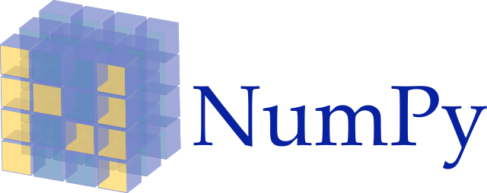
TOOLS AND PLATFORM USED
Tools : Python
Platform : Jupiter Notebook
Library Used : numpy , keras , LSTM, NLTK, Embedding

Slide 8
Dataset Description
Title: The Adventures of Sherlock Holmes
Author: Arthur Conan Doyle
Release Date: November 29, 2002 [EBook #1661]
Last Updated: May 20, 2019
Language: English

Slide 9
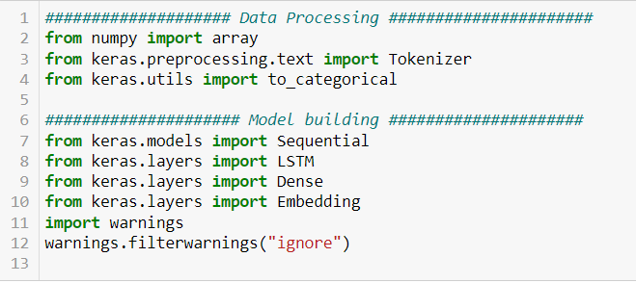
Imported libraries
The necessary libraries are imported. TensorFlow is imported as ‘tf’ to utilize its functionalities for deep learning.
The Sequential model from Keras is imported to build a sequential neural network, and specific layers such as Embedding, LSTM, and Dense are imported.
Numpy is imported as np for generating arrays and regex as a re for data processing pattern recognition.

Slide 10
preprocessing the dataset
The Section carries out a number of operations to prepare text data for a language model’s training. It begins by reading a file and breaking up its text into separate sentences. The Keras Tokenizer class, which learns the vocabulary from the input sentences, tokenizes the text data once it has been parsed.
Converting the string to lower case to get uniformity
Removing Punctuation marks
Removing stopwords
Removing extra white spaces
Instantiating the Tokenizer and converting sentence to word
Getting the total number of words of the data.

Slide 11
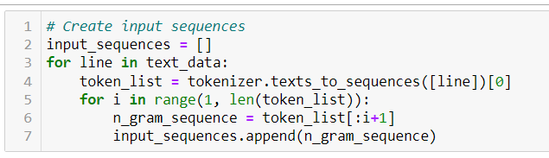
The tokenized data is then used to produce n-gram sequences, each of which contains a range of tokens from the start to the current index.
The sequences are padding with zeros in order to guarantee uniform length.
The input sequences are divided into predictors (X) and labels (Y), where X contains all elements other than the last token of each sequence and Y only the final token.
Finally, the target data y is converted to one-hot encoding, ready for training a language model.

Slide 12
Choosing the best model
LSTM model for one word detection
LSTM model for more then one word detection
LSTM model for more than one word detection using Bidirectional
network

Slide 13
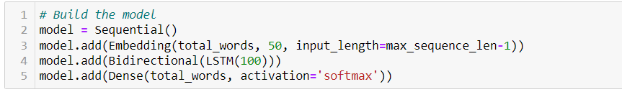
Defining the Model
The input sequences are mapped to dense vectors of fixed size in the first layer, which is an embedding layer.
A Bidirectional LSTM (Long Short-Term Memory) layer with 100 units makes up the second layer. Recurrent neural networks (RNNs) of the LSTM variety may recognize long-term dependencies in sequential input.
A Dense layer with total_words units and softmax activation make up the third layer. The output probabilities for each word in the vocabulary are generated by this layer.

Slide 14
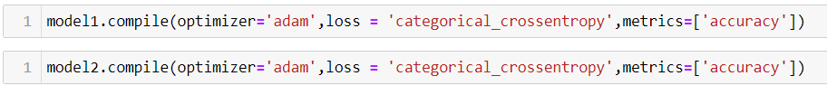
The categorical cross-entropy loss function used in the model is appropriate for multi-class classification applications. Adam is the chosen optimizer, and accuracy is the evaluation metric.

Slide 15
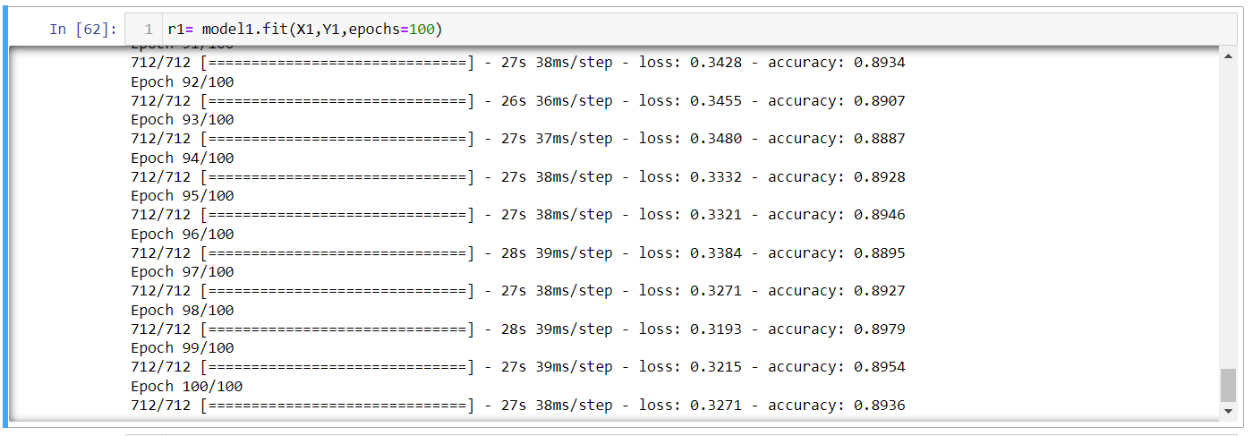
Train the Model
The fit method of the model object is used in this code to train the defined model. As parameters, the input data X and the target data Y are given. The number of iterations that the entire dataset will undergo during training is indicated by the epochs parameter, which is set to 100.
The model is trained for 100 epochs by running this code, and the weights of the model’s layers are adjusted iteratively to reduce the defined loss function and increase precision in predicting the next word in the input sequences.

Slide 16
Training and Optimization
The model is trained using a large corpus of text data, where the input sequences are paired with their corresponding target word. The training process involves optimizing the model’s parameters by minimizing a suitable loss function, such as categorical cross-entropy. The optimization is typically performed using an optimization algorithm like Adam .
The fit method of the model object is used in this code to train the defined model. As parameters, the input data X and the target data Y are given. The number of iterations that the entire dataset will undergo during training is indicated by the epochs parameter, which is set to 100.

Slide 17
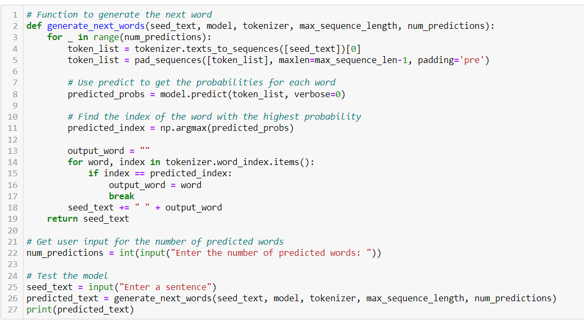
Predicting the next word

Slide 18
Inference and Prediction
The model can be used to predict the next word once it has been trained. The trained model receives an input of a list of words, processes it through the learned architecture, and outputs a probability distribution across the vocabulary. The anticipated next word is then chosen as the one with the highest likelihood.

Slide 19
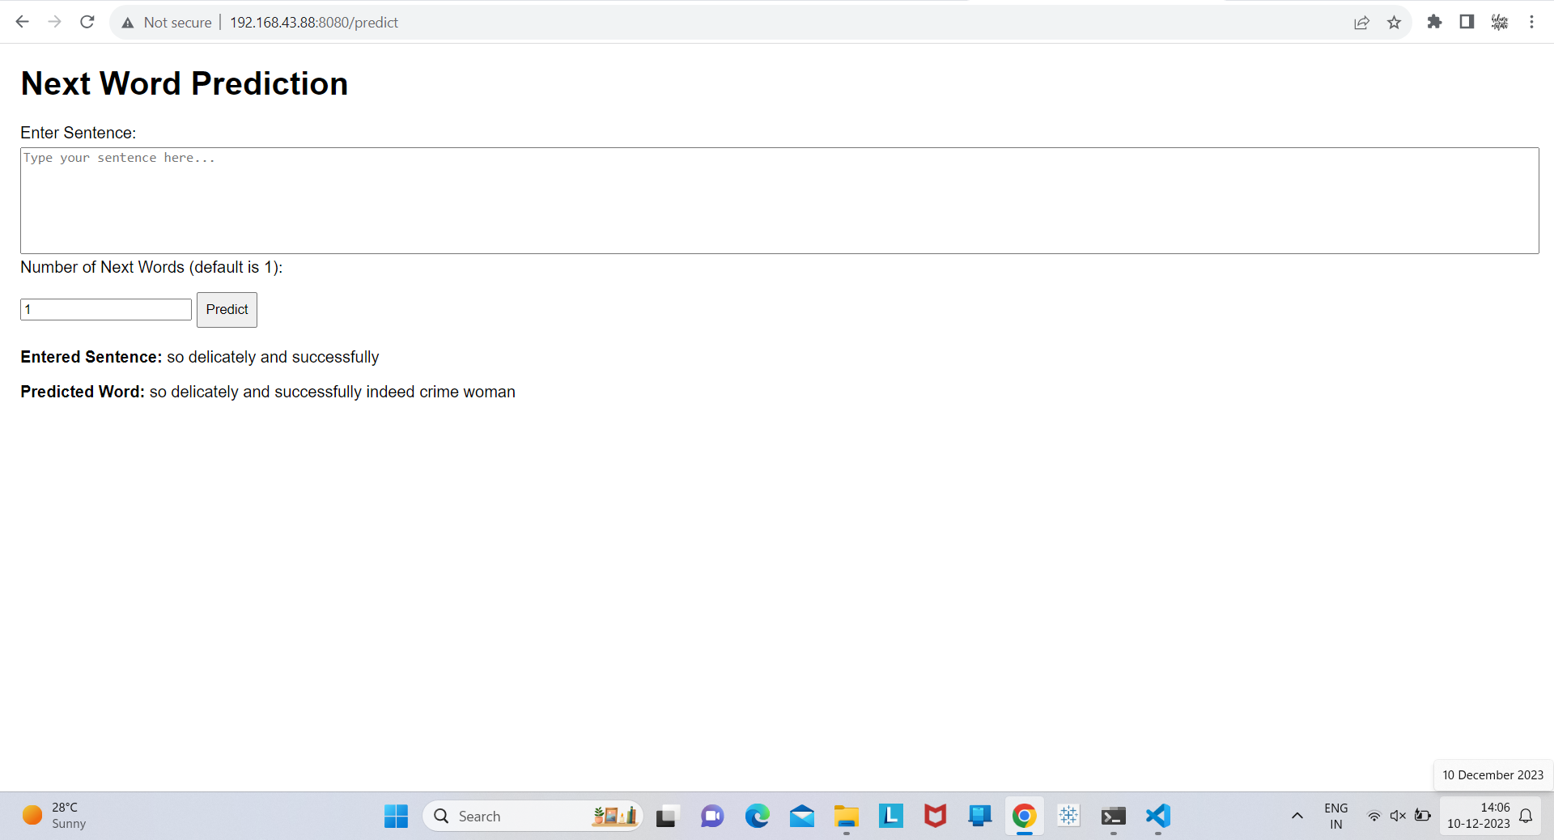
Deployment

Slide 20
Applications
Next word prediction, often seen in autocomplete features on smartphones and other devices, has several practical applications in daily life. Some of these applications include:
Text Messaging and Chat Applications
Email Composition
Search Engines
Word Processors and Document Editing
Predictive Text Keyboards and many more

Slide 21
Conclusion
Deep learning in NLP has several useful applications, including next-word prediction. We can efficiently capture the sequential dependencies in text data and produce precise predictions by applying models like LSTM or GRU. Next-word prediction models keep getting better thanks to deep learning developments and the accessibility of big text corpora, which enhance user experience and enable a variety of NLP applications.

